Slide 1
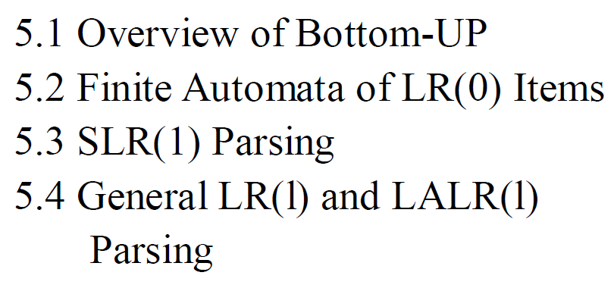
Chapter 5 Bottom-Up Parsing

Slide 2
Bottom-Up Parsing
In terminology similar to that of LL(1) parsers, the most general bottom-up algorithm is called LR(1) parsing (the L indicates that the input is processed from left to right, the R indicates that a rightmost derivation is produced, and the number 1indicates that one symbol of lookahead is used). A consequence of the Power of bottom-up parsing is the fact that it is also meaningful to talk about LR(0) Parsing, where no lookahead is consulted in making parsing decisions. (This is possible because a lookahead token can be examined after it appears on the parsing stack, and this happens it does not count as lookahead.)
An improvement on LR(0) parsing that does make same use of lookahead is called SLR(1) parsing (for simple LR(1) parsing). A method that is slightly more powerful than SLR(1) Parsing but less complex than general LR(1) parsing is called LALR(1) parsing (for lookahead LR(1) parsing).

Slide 3
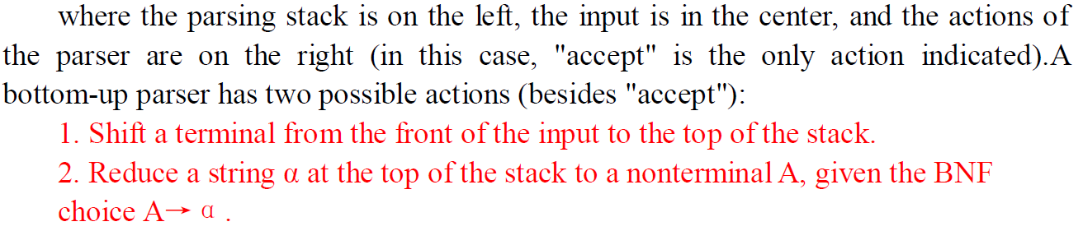
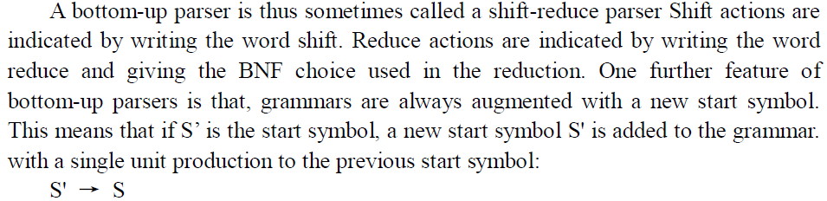
5.1 OVERVIEW OF BOTTOM-UP PARSING

Slide 4
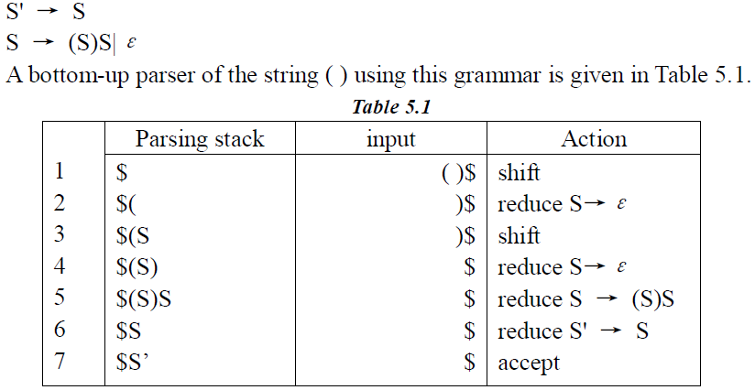
5.1 OVERVIEW OF BOTTOM-UP PARSING

Slide 5
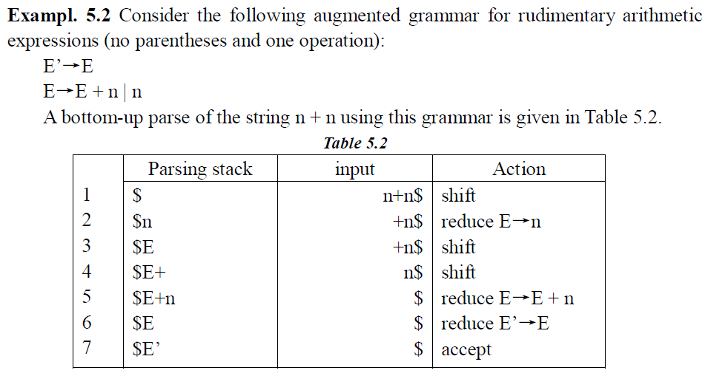

Slide 6
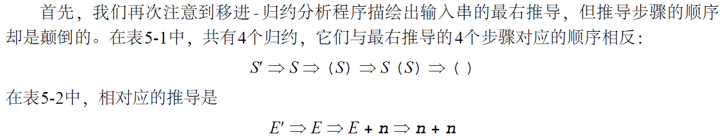
5.1 OVERVIEW OF BOTTOM-UP PARSING
我们将这样的推导中的终结符和非终结符的每个中间串都称作右句型(right sentential for m )。在移进-归约分析中，每个这样的句型都被分析栈和输入分隔开。例如，发生在前面推导中的第3步的右句子格式E + n 出现在表5 - 2的第3、第4和第5步。如果通过符号|| 指出每一时刻栈的顶部位于何处(即：当在栈和输入之间发生了分隔)，则表5 - 2的第3步就由E || + n给出，而其第4步则由E + || n给出。在每一种情况下，分析栈的符号序列都被称作右句型的可行前缀。
因此，E、E+ 和E + n 都是右句型E + n 的可行前缀，但右句子格式n + n 却使和n 作为它的可行前缀(表5 - 2的第1步和第2步)。请注意，n + 不是n + n 的可行前缀。

Slide 7
5.1 OVERVIEW OF BOTTOM-UP PARSING
移进-归约分析程序将终结符从输入移进到栈直到它能执行一个归约以得到下一个右句子格式。它发生在位于栈顶部的符号串匹配用于下一个归约的产生式的右边。这个串、它在右句子格式中发生的位置以及用来归约它的产生式被称作右句型的句柄(handle) 。例如，在右句子格式n + n 中，它的句柄是由最左边的单个记号n 与用来归约它以产生新的右句型E + n的产生式E→n 组成的串。这个新句型的句柄是整个串E + n (一个可行的前缀)以及产生式E→E + n。有时由于表示法上的弊端，我们要用串本身来作为句柄。

Slide 8
5.1 OVERVIEW OF BOTTOM-UP PARSING
Determining the next handle in a parse is the main task of a shift-reduce parser. Note that the string of a handle always forms a complete right-hand side for its production (the production used in the next reduction) and that the rightmost position of the handle string will correspond to the top of the stack when the reduction is to take place. Thus, it seems plausible that a shift-reduce parser will want to determine its actions based on positions in right-hand sides of productions. When these positions reach the right-hand end of a production. then this production is a candidate for a reduction, and it is possible that the handle is at the top of the stack. To be the handle, however, it is not enough for the string at the top of the stack to match the right-hand side of a production. Indeed, if an ε-production is available for reduction, as in Example 5.1, then its right-hand side (the empty string) is always at the top of the stack. Reductions occur only when the resulting string is indeed a right sentential form. For example, in step 3 of Table 5.1 a reduction by S→ε could be performed, but the resulting string( S S ) is not a right sentential form, and thusεis not the handle at this position in the sentential form ( S ) .

Slide 9
5.1 OVERVIEW OF BOTTOM-UP PARSING
判断分析中的下一个句柄是移进-归约分析程序的主要任务。请注意，句柄串总是为它的产生式(在下一步的归约中使用的产生式)构成一个完整的右部，而且当归约发生时，句柄串的最右边的位置将与栈的顶部相对应。所以对于移进-归约分析程序将要基于产生式右边的位置来判断它的动作这一点而言，就看起来有些似是而非了。当这些位置到达产生式的右边末端时，这个产生式就有可能是一个归约，而且句柄还有可能位于栈的顶部。但为了成为句柄，串位于栈的顶部来匹配产生式的右边并不够。实际上，若产生式可用于归约的话（如在例5 . 1中)，那么它的右边(空串)总是位于栈的顶部。归约仅发生在结果串实际为一个右句型时。例如，在表5 - 1的第3步中，可完成用S→ 归约，但是得到的串(S S)并不是右句子格式，所以在句子格式(S)中的这个位置也不是句柄。

Slide 10
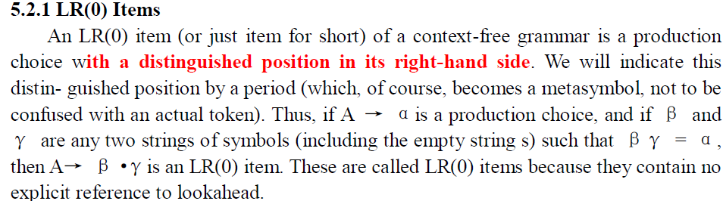
5.2 FINIT AUTOMATA OF LR(0) ITEMS AND LR(0) PARSING

Slide 11
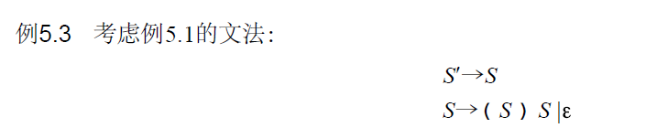
5.2 FINIT AUTOMATA OF LR(0) ITEMS AND LR(0) PARSING

Slide 12
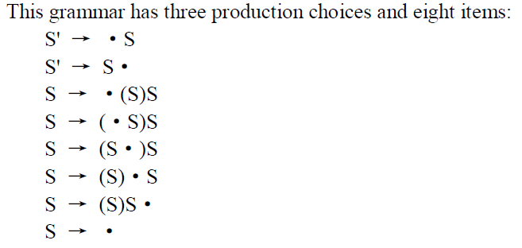
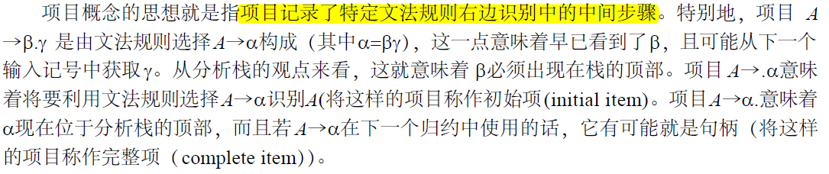

Slide 13
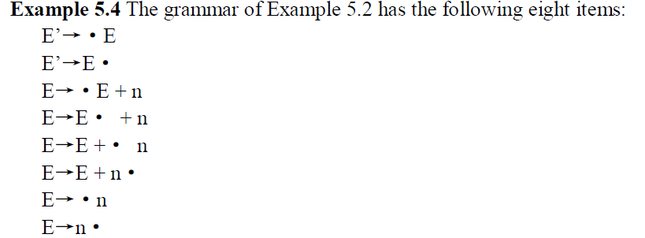

5.2 FINIT AUTOMATA OF LR(0) ITEMS AND LR(0) PARSING

Slide 14
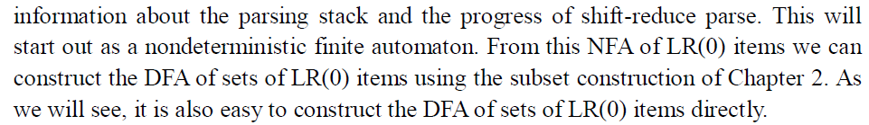
5.2 FINIT AUTOMATA OF LR(0) ITEMS AND LR(0) PARSING
5.2.2 Finite Automata of Items

Slide 15
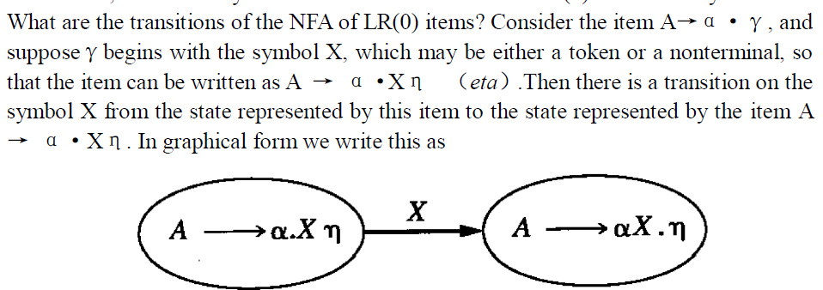
5.2 FINIT AUTOMATA OF LR(0) ITEMS AND LR(0) PARSING

Slide 16
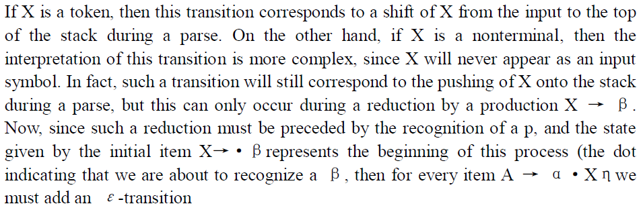

5.2 FINIT AUTOMATA OF LR(0) ITEMS AND LR(0) PARSING

Slide 17
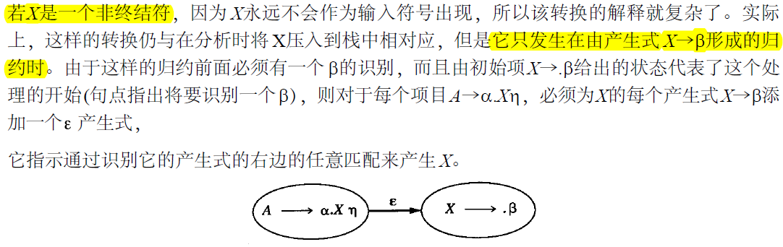
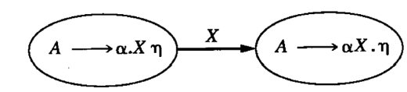
5.2 FINIT AUTOMATA OF LR(0) ITEMS AND LR(0) PARSING

Slide 18
5.2 FINIT AUTOMATA OF LR(0) ITEMS AND LR(0) PARSING
These two cases represent the only transitions in the NFA of LR(0) items. It remains to discuss the choice of initial state and accepting states of the NFA. The start state of the NFA should correspond to the initial state of the parser: the stack is empty, and we are about to recognize an S, where S is the start symbol of the grammar. Thus, any initial item S → ·α constructed from a production choice for S could serve as a start state. Unfortunately, there may be many such production choices for S. The solution is to augment the grammar by a single production S'→S, where S' is a new nonterminal. S' then becomes the start state of the augmented grammar, and the initial item S' →· S becomes the start state of the NFA. This is the reason we have augmented the grammars of the previous examples.

Slide 19
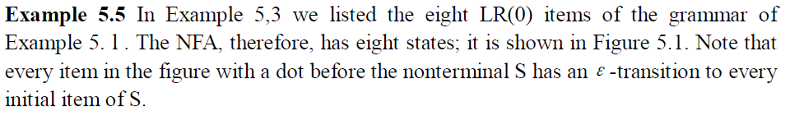
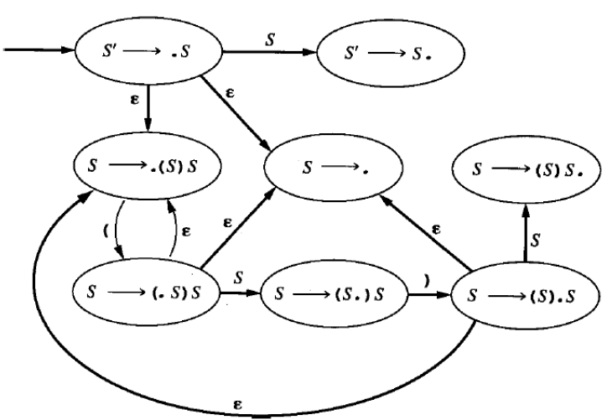
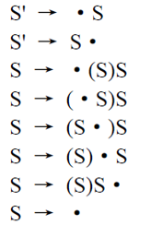

Slide 20
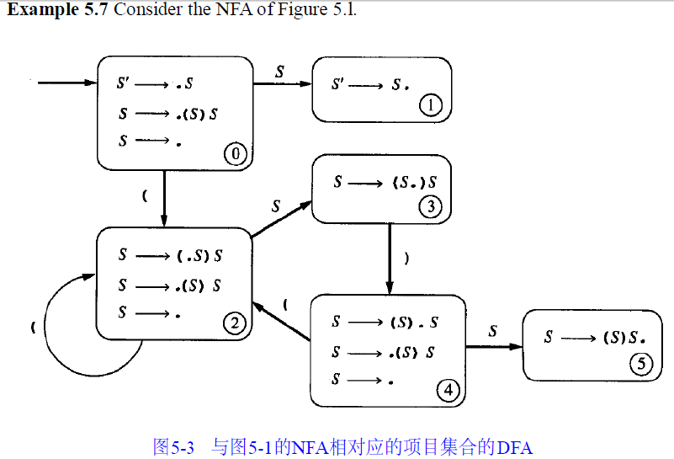

Slide 21
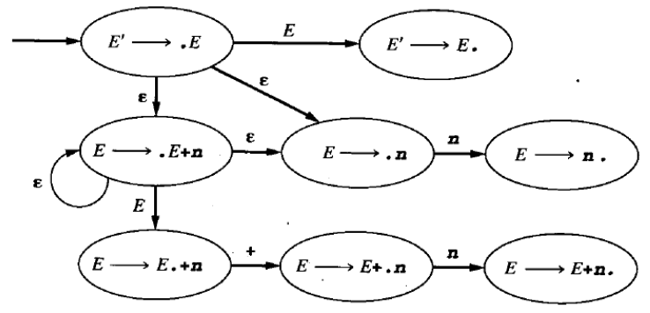
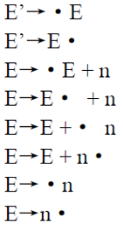
5.2 FINIT AUTOMATA OF LR(0) ITEMS AND LR(0) PARSING

Slide 22
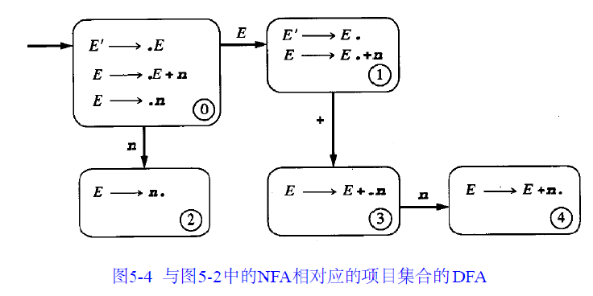
5.2 FINIT AUTOMATA OF LR(0) ITEMS AND LR(0) PARSING

Slide 23
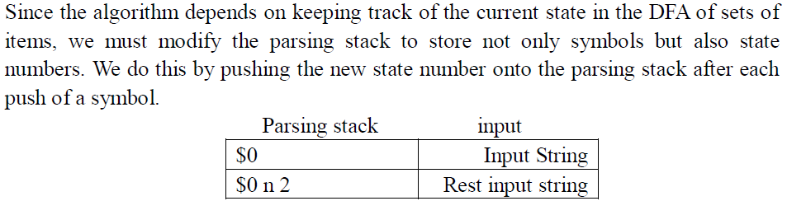
5.2.3 The LR(0) Parsing Algorithm

Slide 24
5.2.3 The LR(0) Parsing Algorithm
1. If state s contains any item of the form A → α·Xβ, where X is a terminal. Then the action is to shift the current input token on to the stack. If this token is X. and state s contains item A → α·Xβ, then the new state to be pushed on the stack is the state containing the item A → α·Xβ. If this token is not X for some item in state s of the form just described, an error is declared.
若状态s 包含了格式A→a.Xb的任何项目，其中X是一个终结符，则动作就是将当前的输入记号移进到栈中。若这个记号是X，且状态s 包含了项目A→a.Xb，则压入到栈中的新状态就是包含了项目A→aX.b的状态。若由于位于刚才所描述的格式的状态s 中的某个项目，这个记号不是X，则声明一个错误。

Slide 25
5.2.3 The LR(0) Parsing Algorithm
2. If state s contains any complete item (an item of the form A → γ·), then the action is to reduce by the rule A → γ·. A reduction by the rule S` → S, where S is the start state, is equivalent to acceptance, provided the input is empty, and error if the input is not empty. In all other cases, for new state is computed as follows. Remove the string γand all of its corresponding states from the parsing stack (the string Y must be at the top of the stack, according to the way the DFA is constructed). Correspondingly, back up in the DFA to the state from which the construction of γbegan (this must be the state uncovered by the removal of γ). Again, by the construction of the DFA, this state must contain an item of the form B → α·Aβ. Push A onto the stack, and push (as the new state) the state containing the item B → αA·β. (Note that this corresponds to following the transition on A in the DFA, which is indeed reasonable, since we are pushing A onto the stack.)

Slide 26
5.2.3 The LR(0) Parsing Algorithm
若状态s 包含了任何完整的项目(格式A→a. 的一个项目)，则动作是用规则A→a归约。假设输入为空，用规则S¢→S归约(其中S是开始状态)与接受相等价；若输入不为空，则出现错误。在所有的其他情况中，新状态的计算如下：将串a及它的所有对应状态从分析栈中删去（根据DFA的构造方式，串a必须位于栈的顶部）。相应地，在DFA中返回到由a开始构造的状态中（这须是由a的删除所揭示的状态）。由于构造DFA，这个状态就还须包含格式B→a.Ab的一个项目。将A压入到栈中，并压入包含了项目B→aA.b的状态（作为新状态）。（请注意，由于正将A压入到栈中，所以这与在DFA中跟随A的转换相对应(这实际上是合理的)。

Slide 27
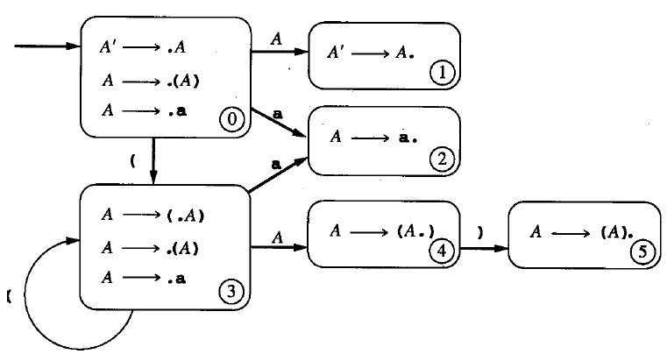
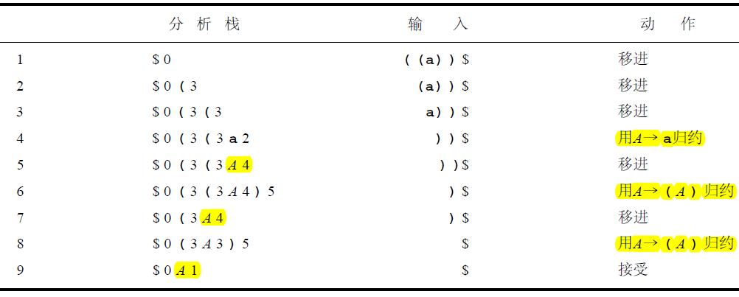

Slide 28
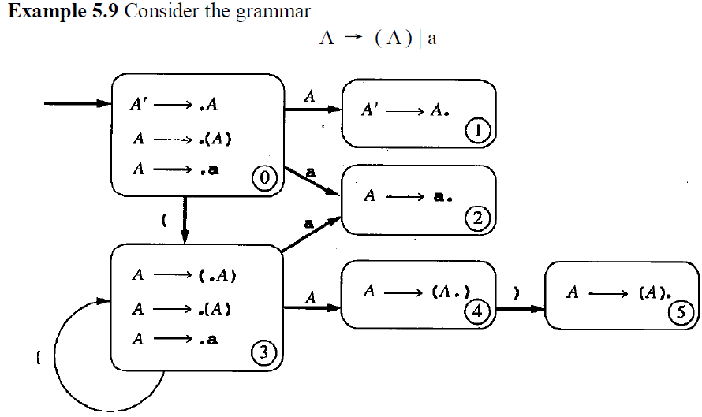
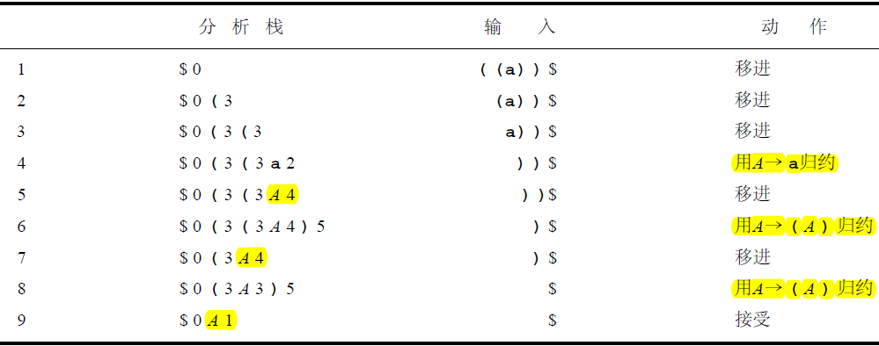
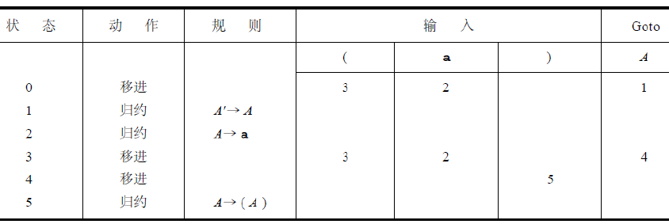

Slide 29
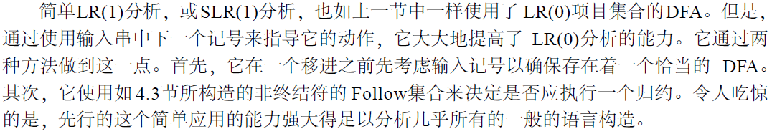
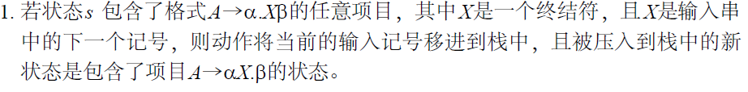
5.3 SLR(1) Parsing
The SLR(1) parsing algorithm. Let s be the current state (a the top of the parsing stack). Then. actions are defined as follows: .
If state s contains any item of form A → α·Xβ,where X is a terminal, and X is the next token in the input string, then the action is to shift the current input token onto the stack, and the new state to be pushed on the stack is the state containing the item A → αX·β.

Slide 30
5.3.1 The SLR(1) Parsing Algorithm
2 If state s contains the complete item A → γ·, and the next token in the input string is in Follow(A), then the action is to reduce by the rule A → γ. A reduction by the rule S' →S, where S is the start state, is equivalent to acceptance; this will happen only if the next input token is $. In all other cases, the new state is computed as follows. Remove the siring γ and all of its corresponding states from the parsing stack. Correspondingly, back up in the DFA to the state from which the construction of γ began. By construction, this state must contain an item of the form B → α·Aβ. Push A onto the stack, and push the state containing the item B → αA·β.
If the next input token is such that neither of the above two cases applies, an error is declared

Slide 31
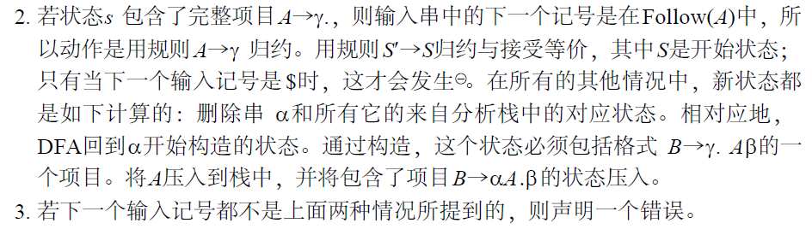
5.3.1 The SLR(1) Parsing Algorithm

Slide 32
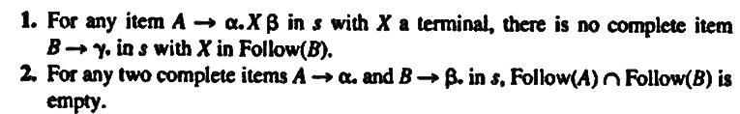
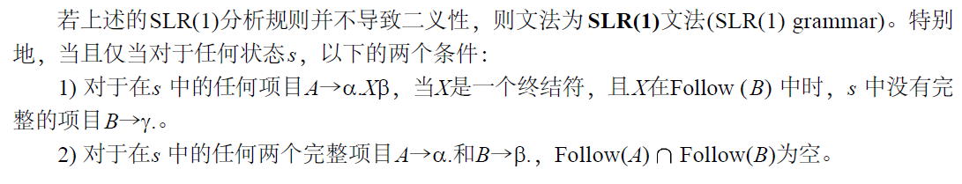
5.3.1 The SLR(1) Parsing Algorithm
A grammar is an SLR(l) grammar if the application of the above SLR(1) parsing rules results in no ambiguity. In particular, a grammar is SLR(1) if and only if, for any state s, the following two conditions are satisfied:
若第1个条件不满足，就表示这是一个移进-归约冲突(shift-reduce conflict)。若第2个条件不满足，就表示这是一个归约-归约冲突(reduce-reduce conflict)。·

Slide 33
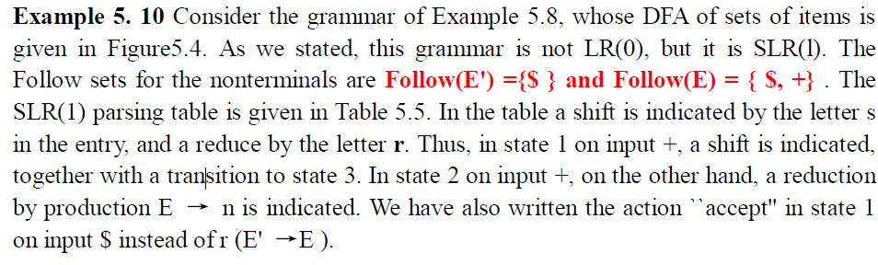
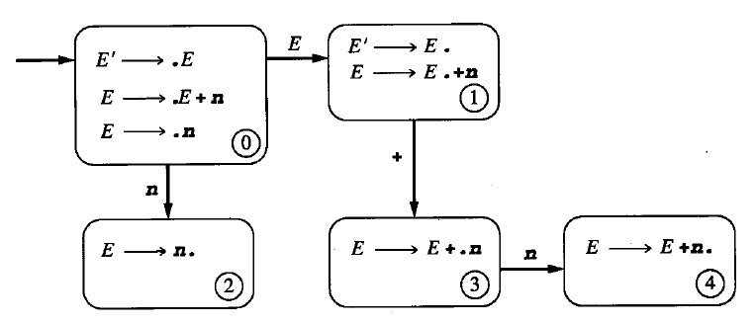
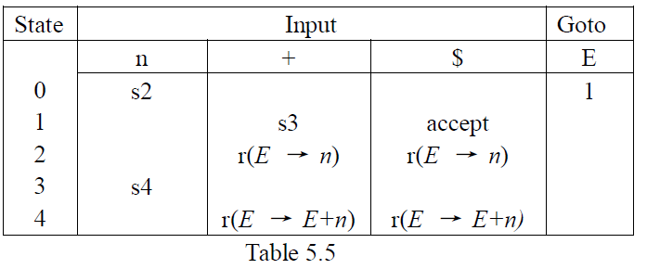

Slide 34
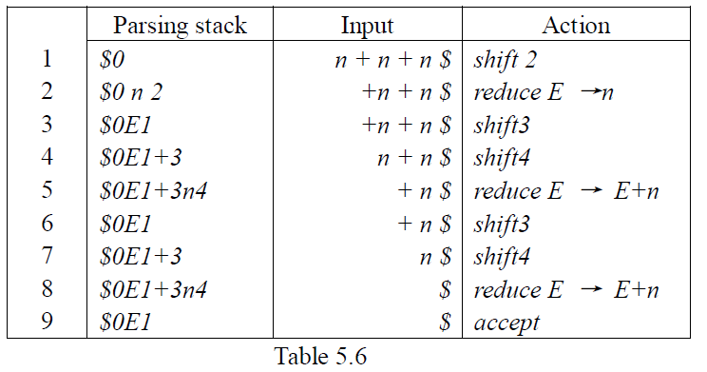

Slide 35
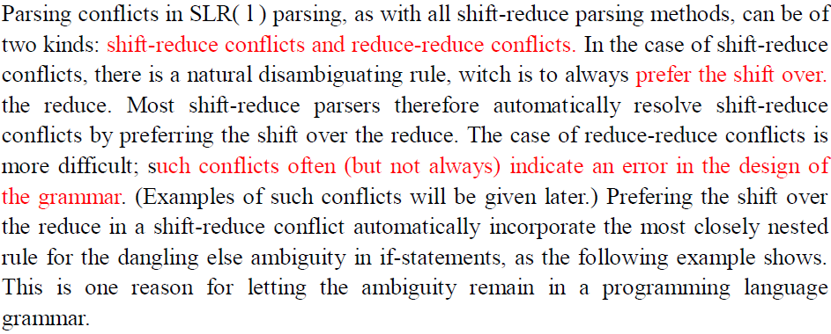
5.3.2 Disambiguating Rules for Parsing Conflicts

Slide 36
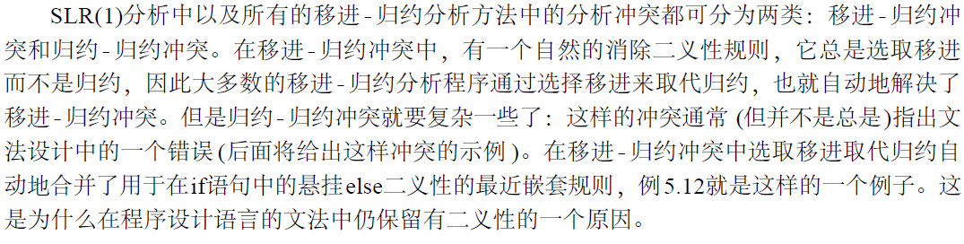
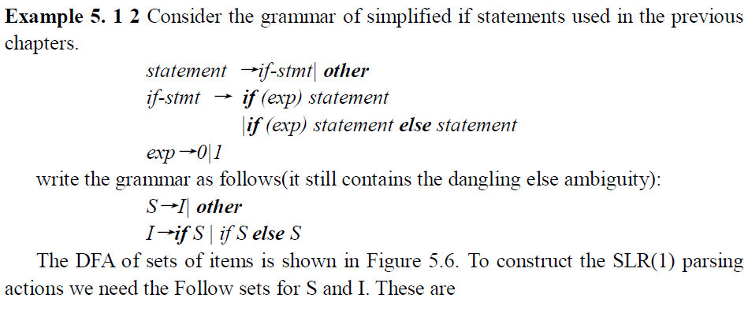

Slide 37
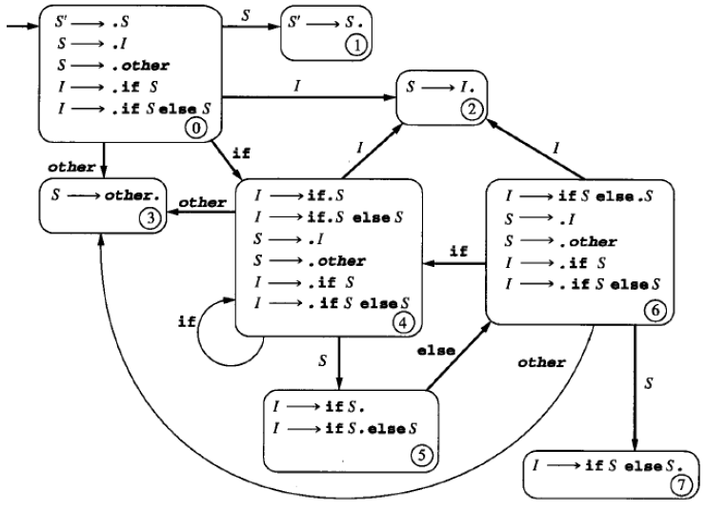

现在就可以看到由悬挂e l s e问题引起的分析冲突了。当发生在D FA的状态5中时，其中的完整项目I → ifS.指出规则I → ifS的归约将发生在输入else和$中，但项目I → if S. else S 却指出输入记号的一个移进将发生在else上。因此悬挂e l s e将导致在S L R ( 1 )分析表的移进-归约冲突。很明显，用移进取代归约的消除二义性的规则可以消除这个冲突，并会根据最近嵌套规则作出分析(若用归约取代移进，就没有办法在D FA中输入状态6或状态7，这将导致虚假的分析错误)

Slide 38
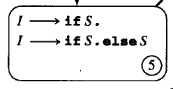
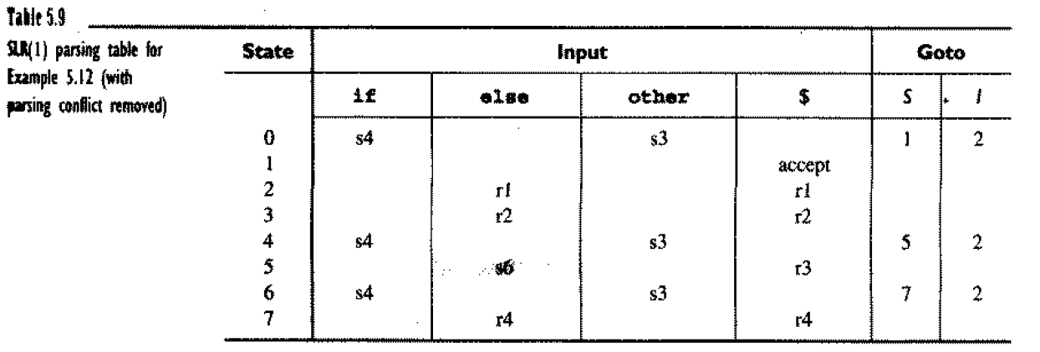

Slide 39
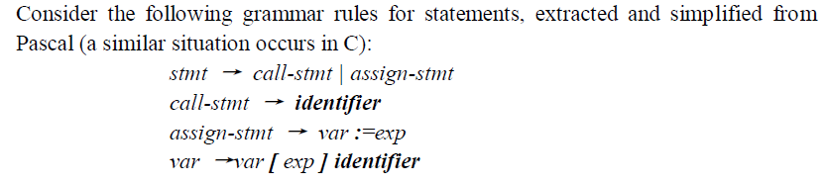
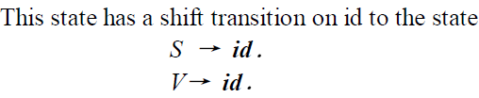
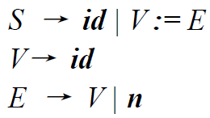
5.3.3 Limits of SLR(1) Parsing Power
Start state：
S’ → ·S
S → ·id
S → ·V := E
V→ ·id

Slide 40
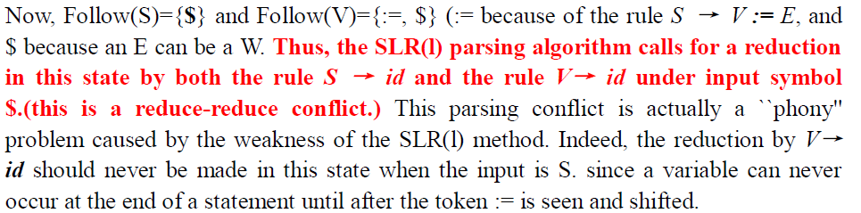
5.3.3 Limits of SLR(1) Parsing Power

Slide 41
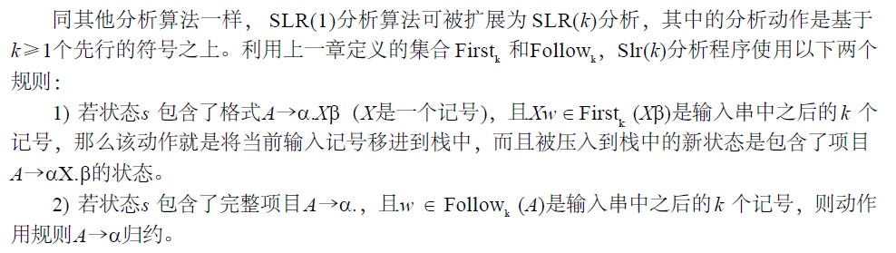
5.3.4 SLR(k) Grammars

Slide 42
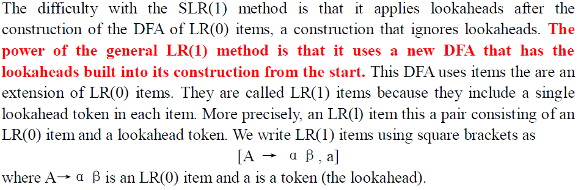
5.4 General LR(1) and LALR(1) Parsing
5.4.1 Finite Automata of LR(1) Items

Slide 43

5.4.1 Finite Automata of LR(1) Items

Slide 44

5.4.1 Finite Automata of LR(1) Items
定义：LR(1)转换(第1部分)的定义(definition of LR(1) transitions (part 1))。假设有LR (1)项目[A→α.Xγ, a]，其中X是任意符号(终结符或非终结符)，那么X就有一个到项目[A→αX.γ, a]的转换。
定义：LR (1)转换(第2部分)的定义(definition of LR(1) transitions (part 2))。假设有LR (1)项目[A→α.Bγ,a]，其中B是一个非终结符，那么对于每个产生式B→β和在First(γa) 中的每个记号b都有到项目[B→.β,b] 的- 转换

Slide 45



Slide 46


5.4.2 The LR(1) Parsing Algorithm

Slide 47

5.4.2 The LR(1) Parsing Algorithm

Slide 48

5.4.2 The LR(1) Parsing Algorithm

Slide 49





Slide 50


下面的示例表明一般的L R ( 1 )分析解决了例5 . 1 3中不能成为S L R ( 1 )的文法的先行问题。

Slide 51


5.4.3 LALR(1) Parsing
LALR(l) parsing is based on the observation that, in many cases, the size of the DFA of sets of LR(1) items is due in part to the existence of many different states that have the same set of first components in their items (the LR(0) items), while differing only in their second components (the lookahead symbols).
L R ( 0 )

Slide 52


5.4.3 LALR(1) Parsing

Slide 53


5.4.3 LALR(1) Parsing

Slide 54

5.4.3 LALR(1) Parsing

Slide 55
5.4.3 LALR(1) Parsing
The algorithm for LALR(l) parsing using the condensed DFA of LAR(l) items is identical to the general LR(1) parsing algorithm described in the previous section. As before, we calla grammar an LALR(l) grammar if no parsing conflicts arise in the LALR(l) parsing algorithm.
In fact, itis possible to compute the DFA of LALR( l) items directly from the DFA of LR(0) items through a process of propagating lookaheads. Though we will not describe this process formally, itis instructive to see how this can be done relatively easily.

Slide 56

5.4.3 LALR(1) Parsing

